Slide 1
Probabilistic Ranking Principle
Hongning Wang
CS@UVa

Slide 2
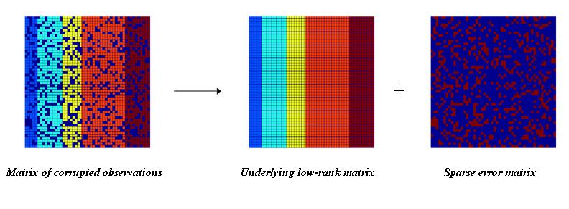
Recap: latent semantic analysis
Solution
Low rank matrix approximation
Imagine this is *true* concept-document matrix
Imagine this is our observed term-document matrix
Random noise over the word selection in each document

Slide 3
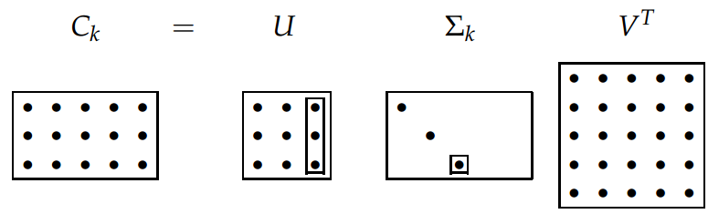
Recap: latent semantic analysis
Solve LSA by SVD
Procedure of LSA
Perform SVD on document-term adjacency matrix
Construct $C_{M×N}^{k}$ by only keeping the largest $k$ singular values in $Σ$ non-zero
Map to a lower dimensional space
$$\hat{Z}=\underset{Z|rank\left(Z\right)=k}{argmin}{{\left\|C−Z\right\|}_{F}}$$
$=\underset{Z|rank\left(Z\right)=k}{argmin}{\sqrt{\sum_{i=1}^{M}{\sum_{j=1}^{N}{{\left(C_{ij}−Z_{ij}\right)}^{2}}}}}$
$=C_{M×N}^{k}$

Slide 4
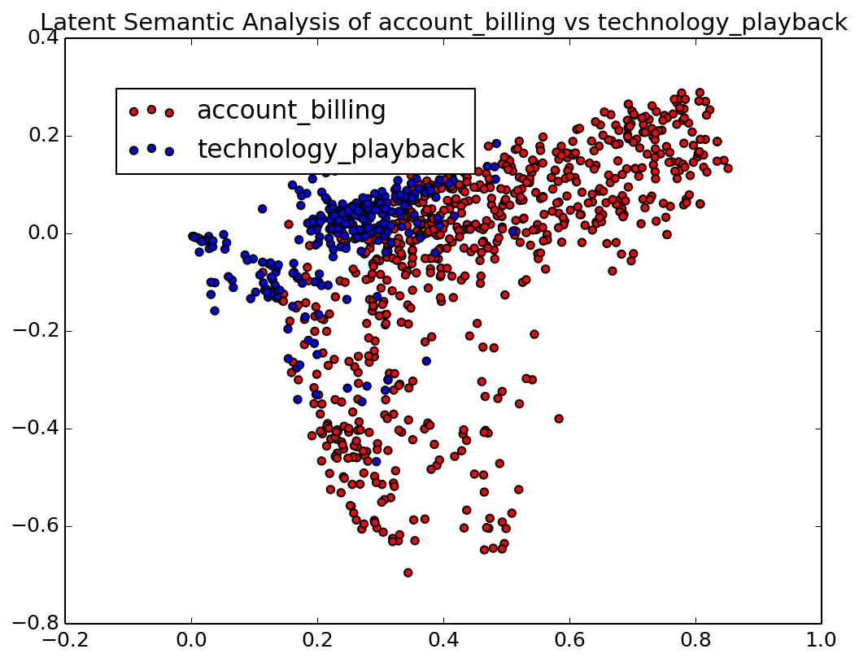
Recap: latent semantic analysis
Visualization

Slide 5
Recap: LSA for retrieval
Project queries into the new document space
$\tilde{q}=qV_{N×k}Σ_{k×k}^{−1}$
Treat query as a pseudo document of term vector
Cosine similarity between query and documents in this lower-dimensional space

Slide 6
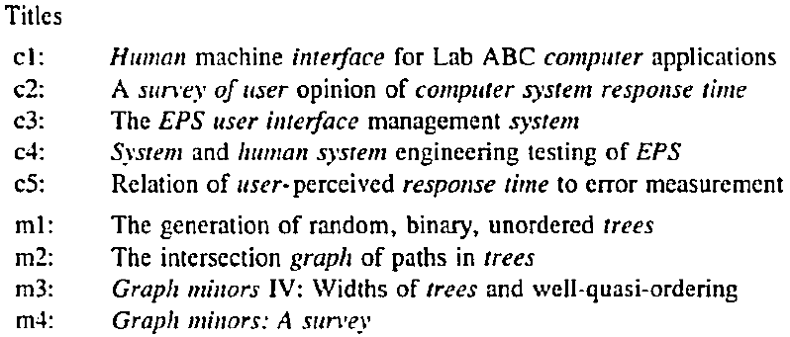
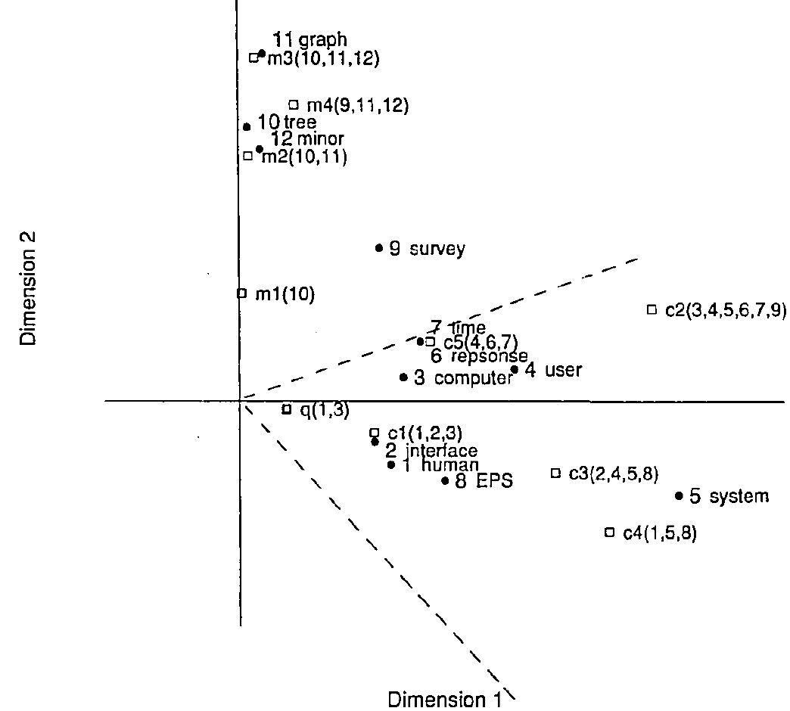
Recap: LSA for retrieval
HCI
Graph theory
q: “human computer interaction”

Slide 7
Notion of relevance
Relevance
Δ(Rep(q), Rep(d))
Similarity
P(r=1|q,d) r ∈{0,1}
Probability of Relevance
P(d →q) or P(q →d)
Probabilistic inference
Today’s lecture
Regression
Model
(Fox 83)
Generative Model
Different inference system
Different
rep & similarity
Doc
generation
Query
generation
…
Prob. concept
space model
(Wong & Yao, 95)
Inference
network
model
(Turtle & Croft, 91)
Vector space
model
(Salton et al., 75)
Prob. distr.
model
(Wong & Yao, 89)
Classical
prob. Model
(Robertson &
Sparck Jones, 76)
LM
approach
(Ponte & Croft, 98)
(Lafferty & Zhai, 01a)

Slide 8
Basic concepts in probability
Random experiment
An experiment with uncertain outcome (e.g., tossing a coin, picking a word from text)
Sample space (S)
All possible outcomes of an experiment, e.g., tossing 2 fair coins, S={HH, HT, TH, TT}
Event (E)
E⊆S, E happens iff outcome is in S, e.g., E={HH} (all heads), E={HH,TT} (same face)
Impossible event ({}), certain event (S)
Probability of event
0 ≤ P(E) ≤ 1

Slide 9
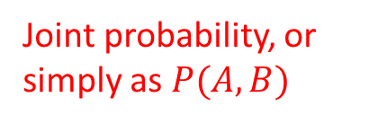
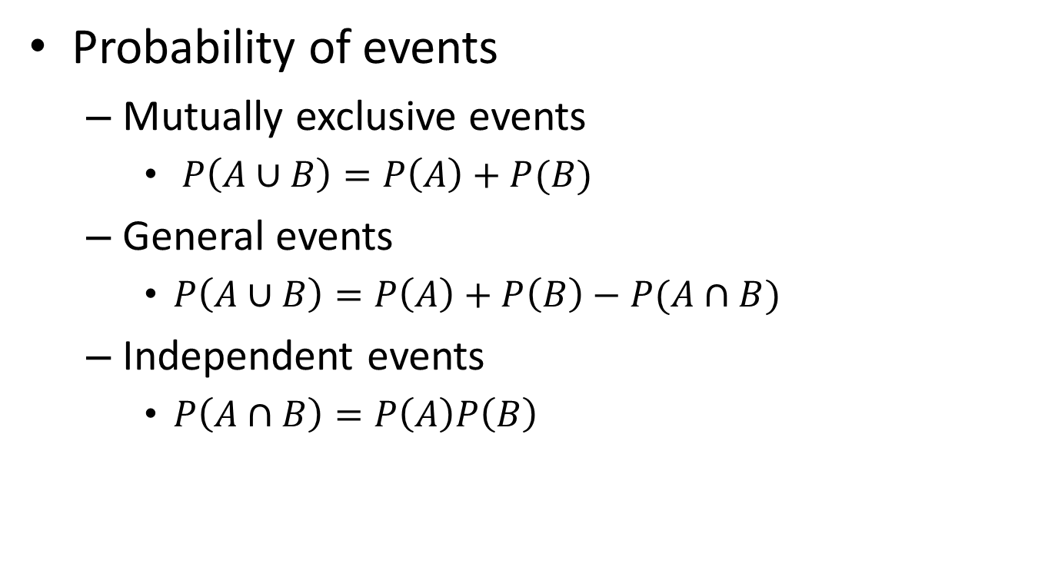
Essential probability concepts
Probability of events
Mutually exclusive events
$P\left(A∪B\right)=P\left(A\right)+P(B)$
General events
$P\left(A∪B\right)=P\left(A\right)+P\left(B\right)−P(A∩B)$
Independent events
$P\left(A∩B\right)=P\left(A\right)P\left(B\right)$
Joint probability, or simply as $P(A,B)$

Slide 10
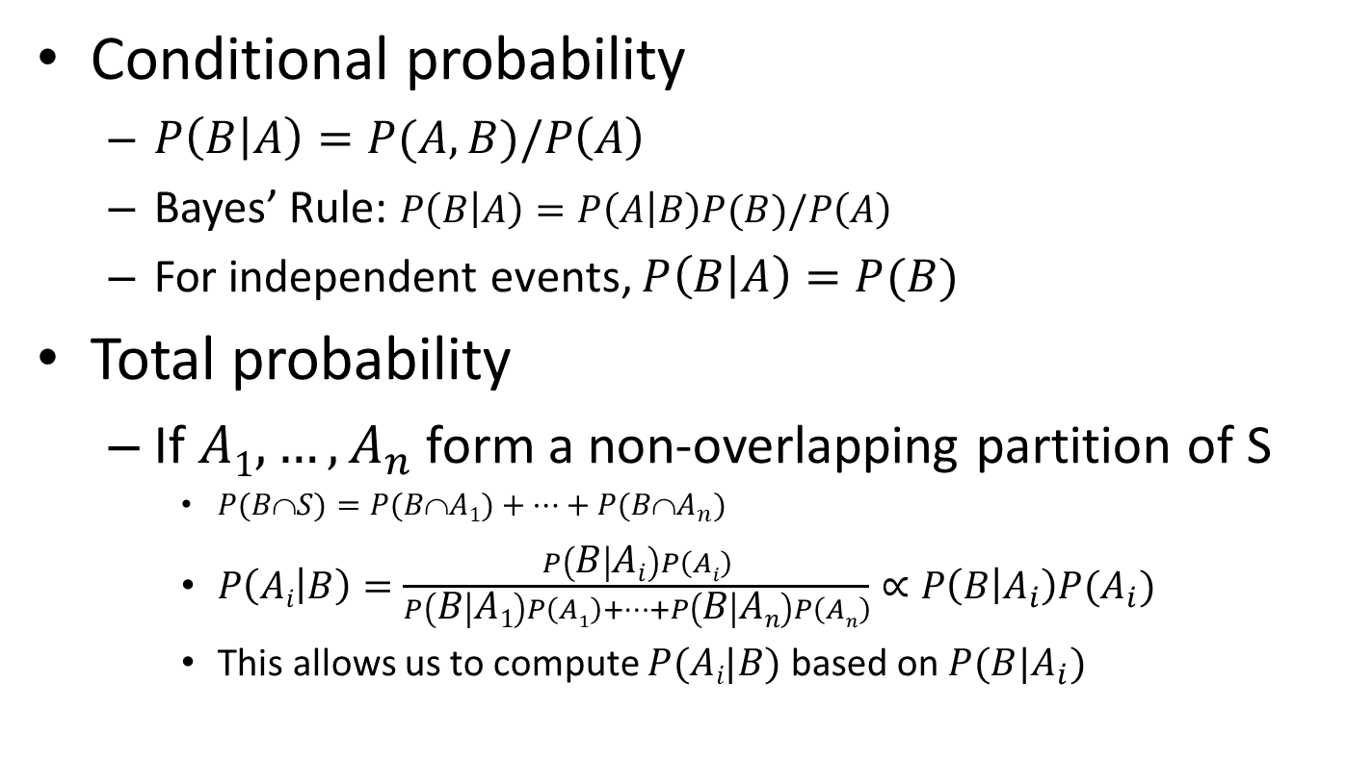
Essential probability concepts
Conditional probability
$P\left(B | A\right)=P(A,B)/P\left(A\right)$
Bayes’ Rule: $P\left(B | A\right)=P\left(A | B\right)P(B)/P\left(A\right)$
For independent events, $P\left(B | A\right)=P(B)$
Total probability
If $A1, …, A_{n}$ form a non-overlapping partition of S
$P(BS)=P(BA1)+…+P(BA_{n})$
$P\left(Ai | B\right)=\frac{P\left(B | Ai\right)P\left(Ai\right)}{P\left(B | A1\right)P\left(A1\right)+…+P\left(B | An\right)P\left(An\right)}∝P\left(B | A_{i}\right)P(A_{i})$
This allows us to compute $P(Ai|B)$ based on $P(B|A_{i})$

Slide 11


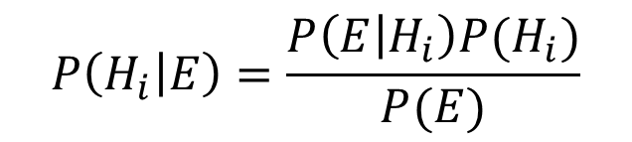

Interpretation of Bayes’ rule
Hypothesis space: $H=\{H1 , …, Hn\}$, Evidence: $E$
$$P\left(H_{i} | E\right)=\frac{P\left(E | H_{i}\right)P(H_{i})}{P(E)}$$
If we want to pick the most likely hypothesis H*, we can drop $P(E)$
Posterior probability of $Hi$
Prior probability of $Hi$
Likelihood of data/evidence given $Hi$

Slide 12
Theoretical justification of ranking
As stated by William Cooper
Rank by probability of relevance leads to the optimal retrieval effectiveness
“If a reference retrieval system’s response to each request is a ranking of the documents in the collections in order of decreasing probability of usefulness to the user who submitted the request, where the probabilities are estimated as accurately as possible on the basis of whatever data made available to the system for this purpose, then the overall effectiveness of the system to its users will be the best that is obtainable on the basis of that data.”

Slide 13
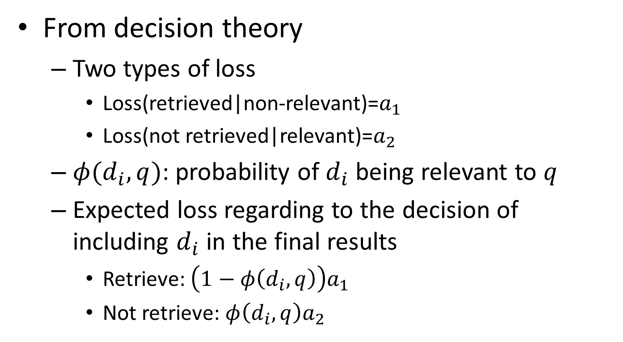
Justification
From decision theory
Two types of loss
Loss(retrieved|non-relevant)=$a_{1}$
Loss(not retrieved|relevant)=$a_{2}$
$φ(d_{i},q)$: probability of $d_{i}$ being relevant to $q$
Expected loss regarding to the decision of including $d_{i}$ in the final results
Retrieve: $\left(1−φ\left(d_{i},q\right)\right)a_{1}$
Not retrieve: $φ\left(d_{i},q\right)a_{2}$
Your decision criterion?

Slide 14
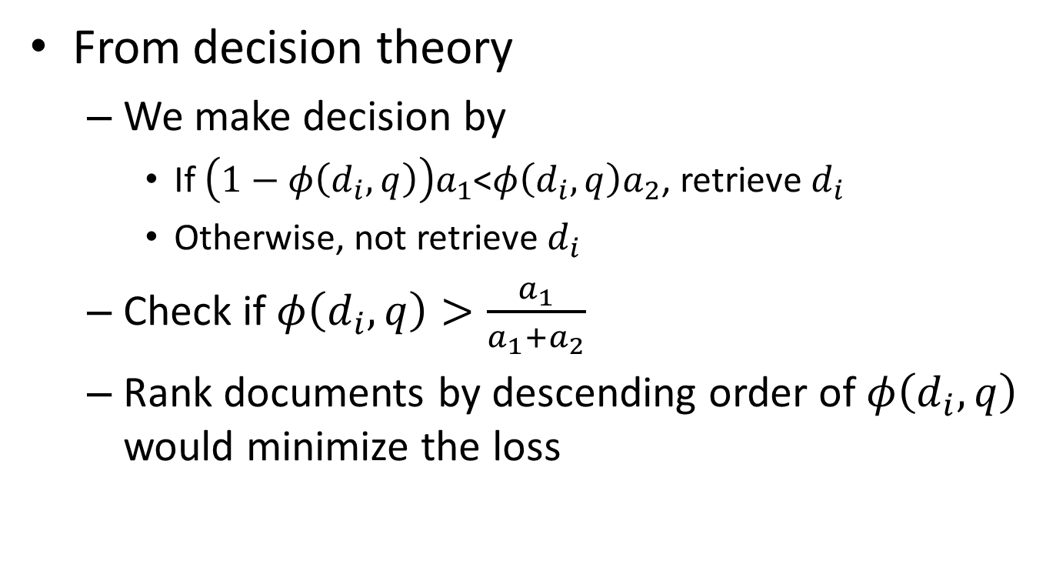
Justification
From decision theory
We make decision by
If $\left(1−φ\left(d_{i},q\right)\right)a_{1}$<$φ\left(d_{i},q\right)a_{2}$, retrieve $d_{i}$
Otherwise, not retrieve $d_{i}$
Check if $φ\left(d_{i},q\right)>\frac{a_{1}}{a_{1}+a_{2}}$
Rank documents by descending order of $φ\left(d_{i},q\right)$ would minimize the loss

Slide 15
According to PRP, what we need is
A relevance measure function F(q,d)
For all q, d₁, d₂, F(q,d₁) > F(q,d₂) iff. p(Rel|q,d₁) >p(Rel|q,d₂)
Assumptions
Independent relevance
Sequential browsing
Most existing research on IR models so far has fallen into
this line of thinking… (Limitations?)

Slide 16
Probability of relevance
Three random variables
Query Q
Document D
Relevance R ∈ {0,1}
Goal: rank D based on P(R=1|Q,D)
Compute P(R=1|Q,D)
Actually, one only needs to compare P(R=1|Q,D₁) with P(R=1|Q,D₂), i.e., rank documents
Several different ways to define P(R=1|Q,D)

Slide 17
Conditional models for P(R=1|Q,D)
Basic idea: relevance depends on how well a query matches a document
P(R=1|Q,D)=g(Rep(Q,D)|θ)
Rep(Q,D): feature representation of query-doc pair
E.g., #matched terms, highest IDF of a matched term, docLen
Using training data (with known relevance judgments) to estimate parameter θ
Apply the model to rank new documents
Special case: logistic regression
a functional form

Slide 18
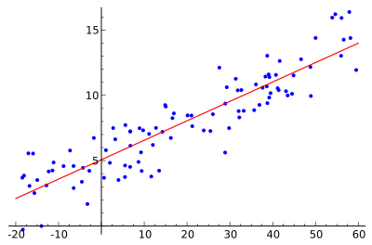
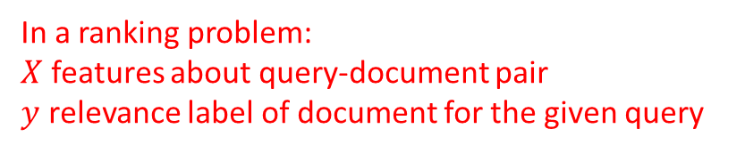
Regression for ranking?
In a ranking problem:
$X$ features about query-document pair
$y$ relevance label of document for the given query
Linear regression
$y←w^{T}X$
Relationship between a scalar dependent variable $y$ and one or more explanatory variables

Slide 19
Features/Attributes for ranking
Typical features considered in ranking problems
Average Absolute Query Frequency
Query Length
Average Absolute Document Frequency
Document Length
Average Inverse Document Frequency
Number of Terms in common between query and document

Slide 20
Regression for ranking
Linear regression
$y←w^{T}X$
Relationship between a scalar dependent variable $y$ and one or more explanatory variables
Y is discrete in a ranking problem!
y
$$y=\left\{\begin{matrix}1 & w^{T}X >0.5 \\ 0 & w^{T}X ≤0.5\end{matrix}\right.$$
1.00
0.75
What if we have an outlier?
0.50
Optimal regression model
0.25
0.00
x

Slide 21

Regression for ranking
Logistic regression
$\text{P}\text{(}\text{R}\text{=1|}\text{Q}\text{,}\text{D}\text{)}=σ\left(w^{T}X\right)=\frac{1}{1+exp⁡(−w^{T}X)}$
Directly modeling posterior of document relevance
Sigmoid function
P(y|x)
1.00
0.75
What if we have an outlier?
0.50
0.25
0.00
x

Slide 22
Conditional models for P(R=1|Q,D) Pros & Cons
Advantages
Absolute probability of relevance available
May re-use all the past relevance judgments
Problems
Performance heavily depends on the selection of features
Little guidance on feature selection
Will be covered with more details in later learning-to-rank discussions

Slide 23
Recap: interpretation of Bayes’ rule
Hypothesis space: $H=\{H1 , …, Hn\}$, Evidence: $E$
$$P\left(H_{i} | E\right)=\frac{P\left(E | H_{i}\right)P(H_{i})}{P(E)}$$
If we want to pick the most likely hypothesis H*, we can drop $P(E)$
Posterior probability of $Hi$
Prior probability of $Hi$
Likelihood of data/evidence given $Hi$

Slide 24
Recap: probabilistic ranking principle
From decision theory
We make decision by
If $\left(1−φ\left(d_{i},q\right)\right)a_{1}$<$φ\left(d_{i},q\right)a_{2}$, retrieve $d_{i}$
Otherwise, not retrieve $d_{i}$
Check if $φ\left(d_{i},q\right)>\frac{a_{1}}{a_{1}+a_{2}}$
Rank documents by descending order of $φ\left(d_{i},q\right)$ would minimize the loss

Slide 25
Recap: conditional models for P(R=1|Q,D)
Basic idea: relevance depends on how well a query matches a document
P(R=1|Q,D)=g(Rep(Q,D)|θ)
Rep(Q,D): feature representation of query-doc pair
E.g., #matched terms, highest IDF of a matched term, docLen
Using training data (with known relevance judgments) to estimate parameter θ
Apply the model to rank new documents
Special case: logistic regression
a functional form

Slide 26
Generative models for P(R=1|Q,D)
Basic idea
Compute Odd(R=1|Q,D) using Bayes’ rule
Assumption
Relevance is a binary variable
Variants
Document “generation”
P(Q,D|R)=P(D|Q,R)P(Q|R)
Query “generation”
P(Q,D|R)=P(Q|D,R)P(D|R)
Ignored for ranking

Slide 27
Document generation model
 | information | retrieval | retrieved | is | helpful | for | you | everyone
Doc1 | 1 | 1 | 0 | 1 | 1 | 1 | 0 | 1
Doc2 | 1 | 0 | 1 | 1 | 1 | 1 | 1 | 0
Ignored for ranking
Model of relevant docs for Q
Model of non-relevant docs for Q
Assume independent attributes of A₁…A_{k} ….(why?)
Let D=d₁…d_{k}, where d_{k} ∈{0,1} is the value of attribute A_{k} (Similarly Q=q₁…q_{k} )
Terms occur in doc
Terms do not occur in doc
document | relevant(R=1) | nonrelevant(R=0)
term present A_{i}=1 | p_{i} | u_{i}
term absent A_{i}=0 | 1-p_{i} | 1-u_{i}

Slide 28
Document generation model
Terms occur in doc
Terms do not occur in doc
Important tricks
Assumption: terms not occurring in the query are equally likely to occur in relevant and nonrelevant documents, i.e., p_{t}=u_{t}
document | relevant(R=1) | nonrelevant(R=0)
term present A_{i}=1 | p_{i} | u_{i}
term absent A_{i}=0 | 1-p_{i} | 1-u_{i}

Slide 29
Robertson-Sparck Jones Model (Robertson & Sparck Jones 76)
(RSJ model)
Two parameters for each term A_{i}:
p_{i} = P(A_{i}=1|Q,R=1): prob. that term A_{i} occurs in a relevant doc
u_{i} = P(A_{i}=1|Q,R=0): prob. that term A_{i} occurs in a non-relevant doc
How to estimate these parameters?
Suppose we have relevance judgments,
“+0.5” and “+1” can be justified by Bayesian estimation as priors
Per-query estimation!

Slide 30
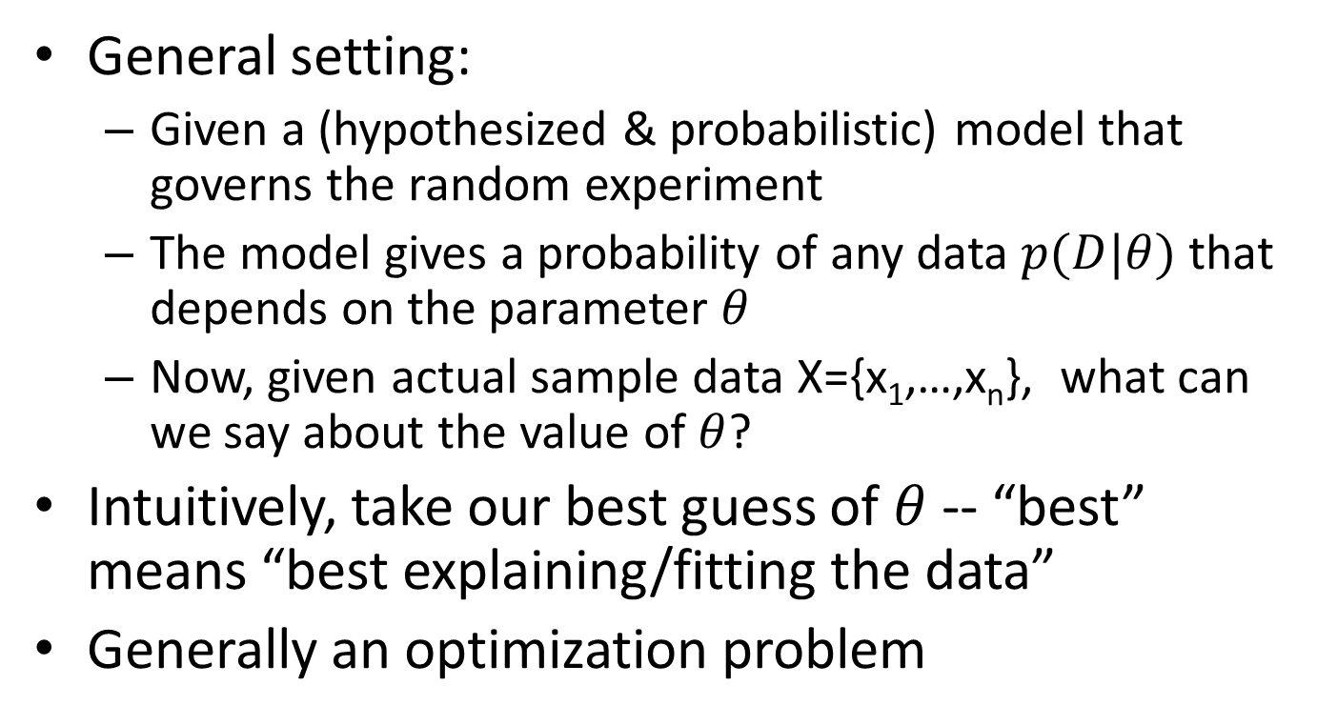
Parameter estimation
General setting:
Given a (hypothesized & probabilistic) model that governs the random experiment
The model gives a probability of any data $p(D|θ)$ that depends on the parameter $θ$
Now, given actual sample data X={x₁,…,x_{n}}, what can we say about the value of $θ$?
Intuitively, take our best guess of $θ$ -- “best” means “best explaining/fitting the data”
Generally an optimization problem

Slide 31

Maximum likelihood vs. Bayesian
Maximum likelihood estimation
“Best” means “data likelihood reaches maximum”
Issue: small sample size
Bayesian estimation
“Best” means being consistent with our “prior” knowledge and explaining data well
A.k.a, Maximum a Posterior estimation
Issue: how to define prior?
$$\hat{θ}={argmax}_{θ}P(X|θ)$$
ML: Frequentist’s point of view
$$\hat{θ}={argmax_{θ}P\left(θ | X\right)=argmax}_{θ}P\left(X | θ\right)P(θ)$$
MAP: Bayesian’s point of view

Slide 32
Illustration of Bayesian estimation
Posterior:
p(θ|X)∝ p(X|θ)p(θ)
Likelihood:
p(X|θ) X=(x₁,…,x_{N})
Prior: p(θ)
θ
θ_{α}: prior mode
θ: posterior mode
θ_{ml}: ML estimate

Slide 33
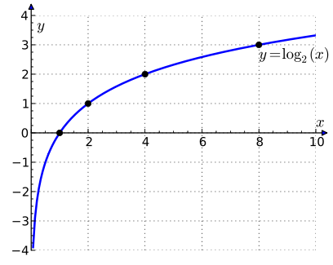

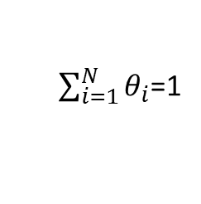
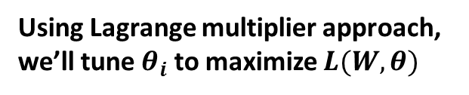
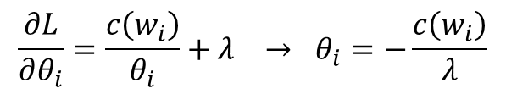

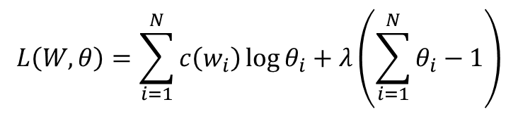
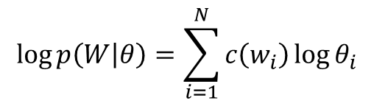

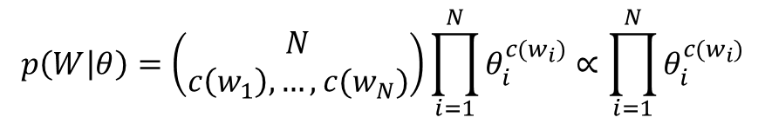

Maximum likelihood estimation
Data: a document d with counts c(w₁), …, c(w_{N})
Model: multinomial distribution $p(W|θ)$ with parameters $θ_{i}=p(w_{i})$
Maximum likelihood estimator: $\hat{θ}=argmax_{θ}p(W|θ)$
$$p\left(W | θ\right)=\left(\begin{matrix}N \\ c\left(w_{1}\right),…,c(w_{N})\end{matrix}\right)\prod_{i=1}^{N}{θ_{i}^{c(w_{i})}}∝\prod_{i=1}^{N}{θ_{i}^{c(w_{i})}}$$
$$\log{p\left(W | θ\right)}=\sum_{i=1}^{N}{c\left(w_{i}\right)\log{θ_{i}}}$$
$$L\left(W,θ\right)=\sum_{i=1}^{N}{c\left(w_{i}\right)\log{θ_{i}}}+λ\left(\sum_{i=1}^{N}{θ_{i}}−1\right)$$
Using Lagrange multiplier approach, we’ll tune $θ_{i}$ to maximize $L(W,θ)$
$$\frac{∂L}{∂θ_{i}}=\frac{c\left(w_{i}\right)}{θ_{i}}+λ → θ_{i}=−\frac{c\left(w_{i}\right)}{λ}$$
Set partial derivatives to zero
$$λ=−\sum_{i=1}^{N}{c\left(w_{i}\right)}$$
Since
$\sum_{i=1}^{N}{θ_{i}}$=1
we have
Requirement from probability
$$θ_{i}=\frac{c\left(w_{i}\right)}{\sum_{i=1}^{N}{c\left(w_{i}\right)}}$$
ML estimate

Slide 34
Robertson-Sparck Jones Model (Robertson & Sparck Jones 76)
(RSJ model)
Two parameters for each term A_{i}:
p_{i} = P(A_{i}=1|Q,R=1): prob. that term A_{i} occurs in a relevant doc
u_{i} = P(A_{i}=1|Q,R=0): prob. that term A_{i} occurs in a non-relevant doc
How to estimate these parameters?
Suppose we have relevance judgments,
“+0.5” and “+1” can be justified by Bayesian estimation as priors
Per-query estimation!

Slide 35
RSJ Model without relevance info (Croft & Harper 79)
 | information | retrieval | retrieved | is | helpful | for | you | everyone
Doc1 | 1 | 1 | 0 | 1 | 1 | 1 | 0 | 1
Doc2 | 1 | 0 | 1 | 1 | 1 | 1 | 1 | 0
(RSJ model)
Suppose we do not have relevance judgments,
- We will assume p_{i} to be a constant
- Estimate u_{i} by assuming all documents to be non-relevant
Reminder:
N: # documents in collection
n_{i}: # documents in which term A_{i} occurs
IDF weighted Boolean model?

Slide 36
RSJ Model: summary
The most important classic probabilistic IR model
Use only term presence/absence, thus also referred to as Binary Independence Model
Essentially Naïve Bayes for doc ranking
Designed for short catalog records
When without relevance judgments, the model parameters must be estimated in an ad-hoc way
Performance isn’t as good as tuned VS models

Slide 37
Improving RSJ: adding TF
Let D=d₁…d_{k}, where d_{k} is the frequency count of term A_{k}
Eliteness: if the term is about the concept asked in the query
2-Poisson mixture model for TF
Many more parameters to estimate! (how many exactly?)
Compound with document length!

Slide 38
BM25/Okapi approximation (Robertson et al. 94)
Idea: model p(D|Q,R) with a simpler function that approximates 2-Possion mixture model
Observations:
log O(R=1|Q,D) is a sum of term weights occurring in both query and document
Term weight W_{i}= 0, if TF_{i}=0
W_{i} increases monotonically with TF_{i}
W_{i} has an asymptotic limit
The simple function is

Slide 39
Adding doc. length
Incorporating doc length
Motivation: the 2-Poisson model assumes equal document length
Implementation: penalize long doc
where
Pivoted document length normalization

Slide 40
Adding query TF
Incorporating query TF
Motivation
Natural symmetry between document and query
Implementation: a similar TF transformation as in document TF
The final formula is called BM25, achieving top TREC performance
BM: best match

Slide 41
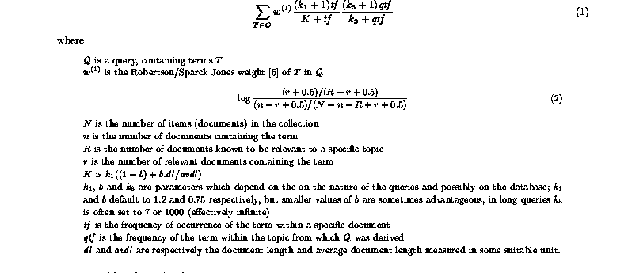
The BM25 formula
“Okapi TF/BM25 TF”
becomes IDF when no relevance info is available

Slide 42

The BM25 formula
TF-IDF component for document
TF component for query
A closer look
$b$ is usually set to [0.75, 1.2]
$k_{1}$is usually set to [1.2, 2.0]
$k_{2}$ is usually set to (0, 1000]
Vector space model with TF-IDF schema!

Slide 43
Extensions of “Doc Generation” models
Capture term dependence ^{[Rijsbergen & Harper 78]}
Alternative ways to incorporate TF ^{[Croft 83, Kalt96]}
Feature/term selection for feedback ^{[Okapi’s TREC reports]}
Estimate of the relevance model based on pseudo feedback ^{[Lavrenko & Croft 01]}
to be covered later

Slide 44
Query generation models
Query likelihood p(q| θ_{d})
Document prior
Assuming uniform document prior, we have
Now, the question is how to compute ?
Generally involves two steps:
(1) estimate a language model based on D
(2) compute the query likelihood according to the estimated model
Language models, we will cover it in next lecture!

Slide 45
What you should know
Essential concepts in probability
Justification of ranking by relevance
Derivation of RSJ model
Maximum likelihood estimation
BM25 formula

Slide 46
Today’s reading
Chapter 11. Probabilistic information retrieval
11.2 The Probability Ranking Principle
11.3 The Binary Independence Model
11.4.3 Okapi BM25: a non-binary model

